Slide 1


Smart Irrigation Decision Support System Using Simulated Soil Moisture and Weather Data
Java-Based Rule-Driven Irrigation Simulation Project
CSA 0904 – Java Programming
Presented By O. Bhanu prakash Reddy 192372075
M.Mahi reddy 192324082
K.Haneesh 192324084
Sri Hari 192372222
Antony Ajay 192524414
Guided By
Dr. Thalapathy Rajasekaran

Slide 2
Introduction
Efficient irrigation is essential for sustainable agriculture, yet many decisions are still made manually without real-time environmental data.
Smart Irrigation Decision Support System is a Java-based application that simulates soil moisture and weather conditions for demonstration purposes.
The system analyzes simulated environmental data using predefined decision rules to recommend irrigation actions.
No real IoT sensors are used; simulated data is generated to demonstrate the complete decision-making workflow.
The system provides recommendations, alerts, and historical reports to support informed irrigation decisions.

Slide 3
Objective
To design a Java-based decision support system for irrigation management.
To simulate soil moisture, temperature, humidity, and rainfall data for demonstration purposes.
To implement rule-based logic that determines irrigation requirement and water quantity.
To generate real-time recommendations and alerts based on simulated conditions.
To maintain irrigation history and generate summary reports for water usage analysis.
To demonstrate core Java OOP concepts through a practical agricultural use case.

Slide 4
Problem Statement
Imagine a small farmer named Ramesh, who owns a few acres of farmland.
Every morning, he walks through his fields, touches the soil with his hands, looks at the sky, and decides whether his crops need water.
Some days he irrigates more than necessary, wasting valuable water.
On other days, he delays irrigation, causing the crops to experience water stress and reducing their yield.
Ramesh hears about modern IoT-based smart irrigation systems, but the cost of sensors, controllers, and maintenance is far beyond what he can afford.
Like many small farmers, he continues to rely on experience and guesswork instead of data-driven decisions.

Slide 5
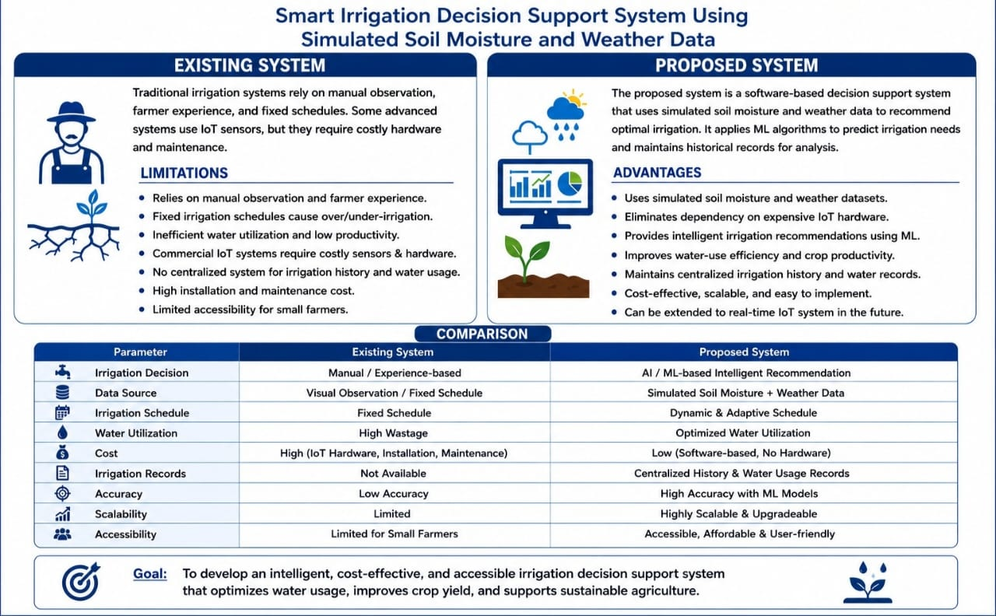
Existing System AND Proposed System

Slide 6
System Architecture
1
2
3
4
5
User & Farm
Management
Soil Moisture &
Weather Simulation
Irrigation
Decision Engine
Recommendation
& Alerts
Report Generation
& History
Each module hands its output to the next, forming a complete simulate-to-report irrigation pipeline.

Slide 7
Module 1: User & Farm Management
Aspect | Details
Requirements | • User Registration • Login Authentication • Farm Information Storage
Task | • Register farmers • Store farm details • Update farm information
Parameters | User ID, Name, Farm Area, Soil Type, Crop Type, Location
Outcome | • User account created • Farm information stored successfully
Techniques | Java OOP, Encapsulation, Classes, Constructors, Collections

Slide 8
Module 2: Soil Moisture & Weather Data Simulation
Aspect | Details
Requirements | • Soil Moisture Simulator • Weather Generator
Task | • Generate simulated sensor values • Simulate weather conditions
Parameters | Soil Moisture, Temperature, Humidity, Rainfall, Weather Condition
Outcome | • Simulated environmental dataset generated
Techniques | Random Class, Arrays, ArrayList, Java Math Library

Slide 9
Module 3: Irrigation Decision Engine
Aspect | Details
Requirements | • Decision Support Logic
Task | • Analyze simulated data • Decide irrigation requirement
Parameters | Moisture Threshold, Rainfall Prediction, Crop Water Requirement
Outcome | • Irrigation ON/OFF • Required water quantity
Techniques | Rule-Based Logic, If-Else, Java Methods

Slide 10
Module 4: Recommendation & Alerts
Aspect | Details
Requirements | • Recommendation System • Alert Generation
Task | • Recommend irrigation schedule • Notify users
Parameters | Water Amount, Irrigation Time, Weather Alert, Soil Status
Outcome | • Recommendation displayed • Alert messages generated
Techniques | String Handling, Exception Handling, Conditional Statements

Slide 11
Module 5: Report Generation & History
Aspect | Details
Requirements | • Data Storage • Report Generation
Task | • Store irrigation history • Generate reports
Parameters | Date, Soil Moisture, Weather, Irrigation Decision, Water Usage
Outcome | • Daily history • Summary report • Water usage analysis
Techniques | File Handling, Collections, Searching, Sorting

Slide 12
System Flow
1. User
Registration
2. Farm
Details
3. Generate Simulated
Soil & Weather Data
4. Analyze
Data
8. Generate
Reports
7. Save
History
6. Recommendation
& Alerts
5. Irrigation
Decision Engine

Slide 13
Conclusion
The Smart Irrigation Decision Support System demonstrates how Java can be used to build a rule-based agricultural decision-making tool.
Simulated soil moisture and weather data enable a safe, hardware-free demonstration of irrigation logic.
The system combines data simulation, decision-making, recommendations, and reporting into a single cohesive application.
It serves as a strong foundation for future integration with real sensors and machine learning models.

Slide 14


